Slide 1
Non Uniform Sampling ADC
What’s an adc
Conventional sampling
Non-uniform sampling

Slide 2
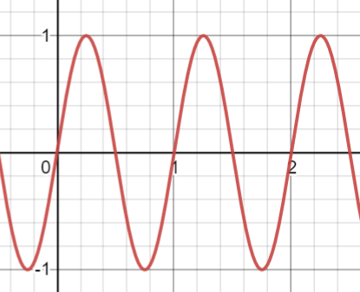
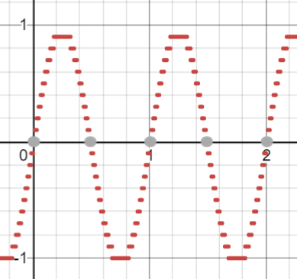
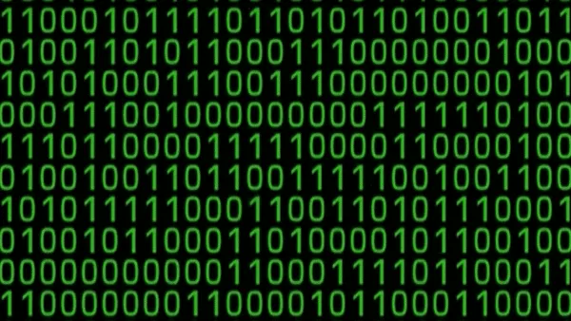
Analog-to-Digital Converter
Benefits:
Data transmission
Evolving technology
More Efficient
Smaller

Slide 3
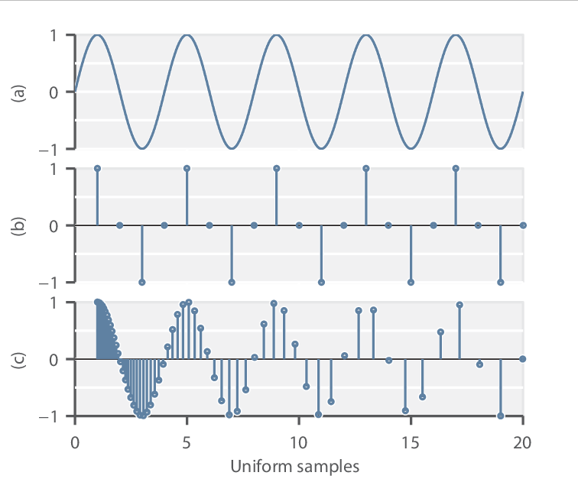
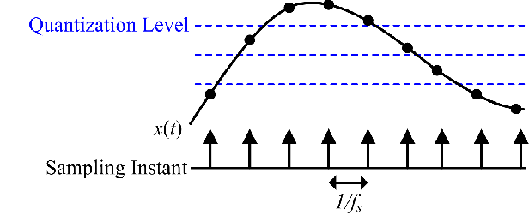
Conventional uniform sampling

Slide 4
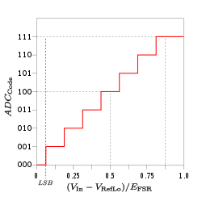
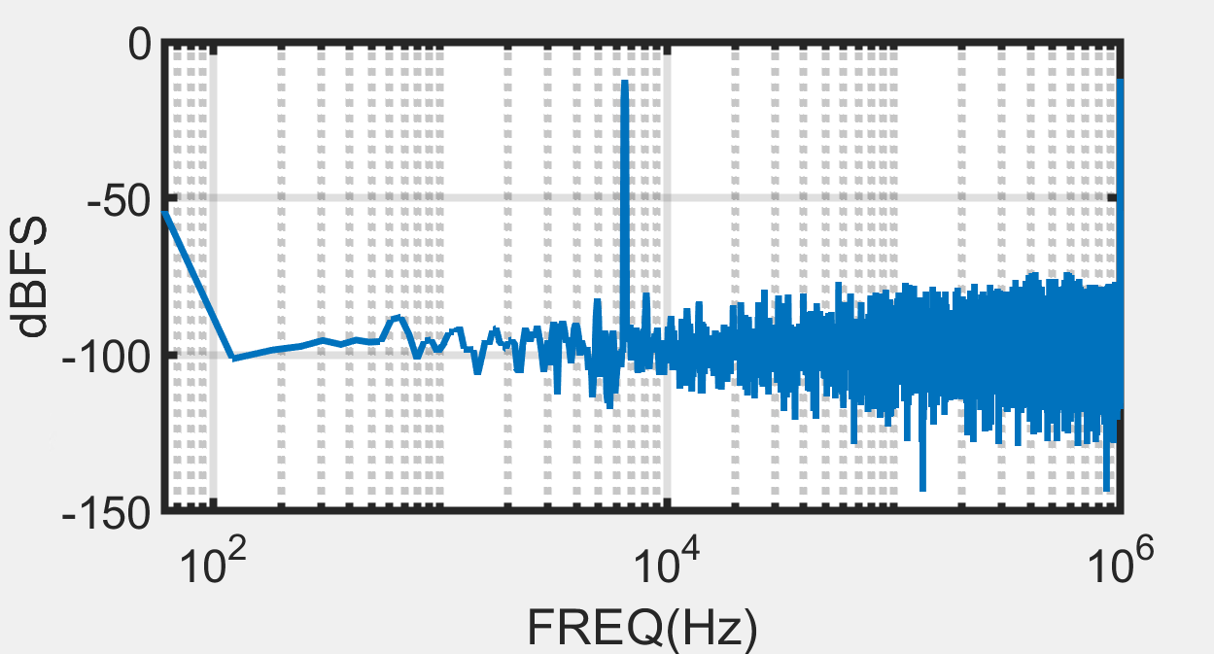
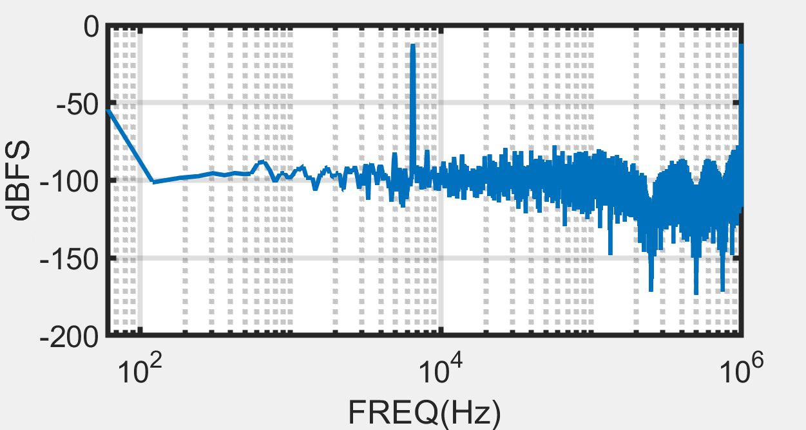
Conventional sampling filter
Signal to Noise Ratio
Noisy signals because of level sampling
Get rid of high frequency using filter
Bigger SNR is better

Slide 5
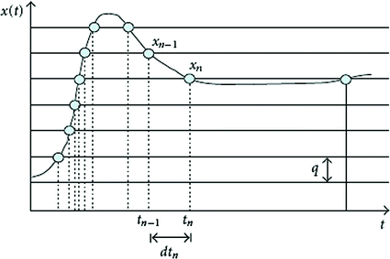
Non-uniform sampling
NUS VS conventional
Less amount of data
Concentrated data
Same avg sampling rate
Better SNR

Slide 6
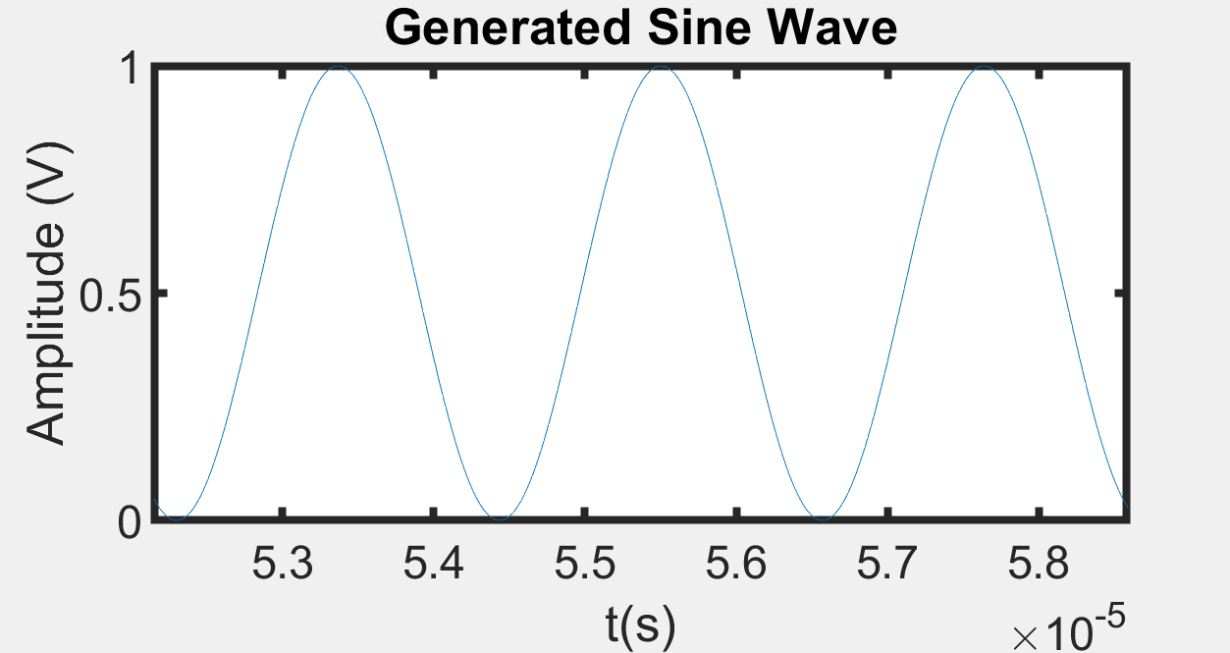

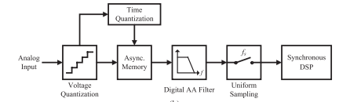
Non-uniform sampling filter

Slide 7
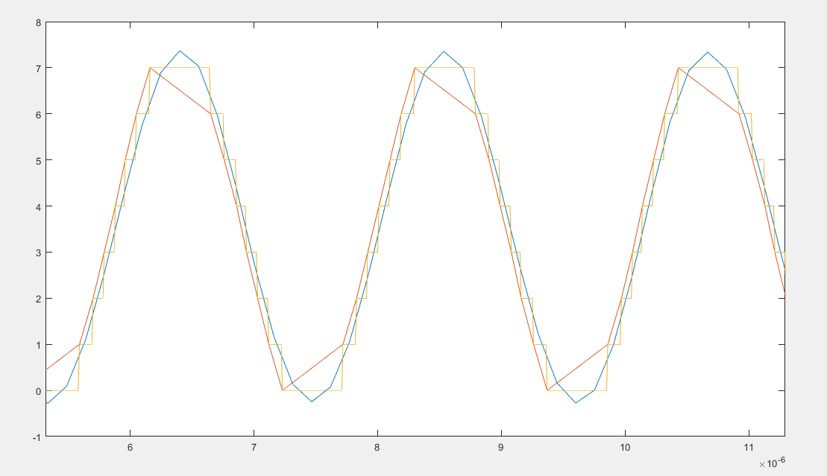
Non-uniform sampling filter

Slide 8
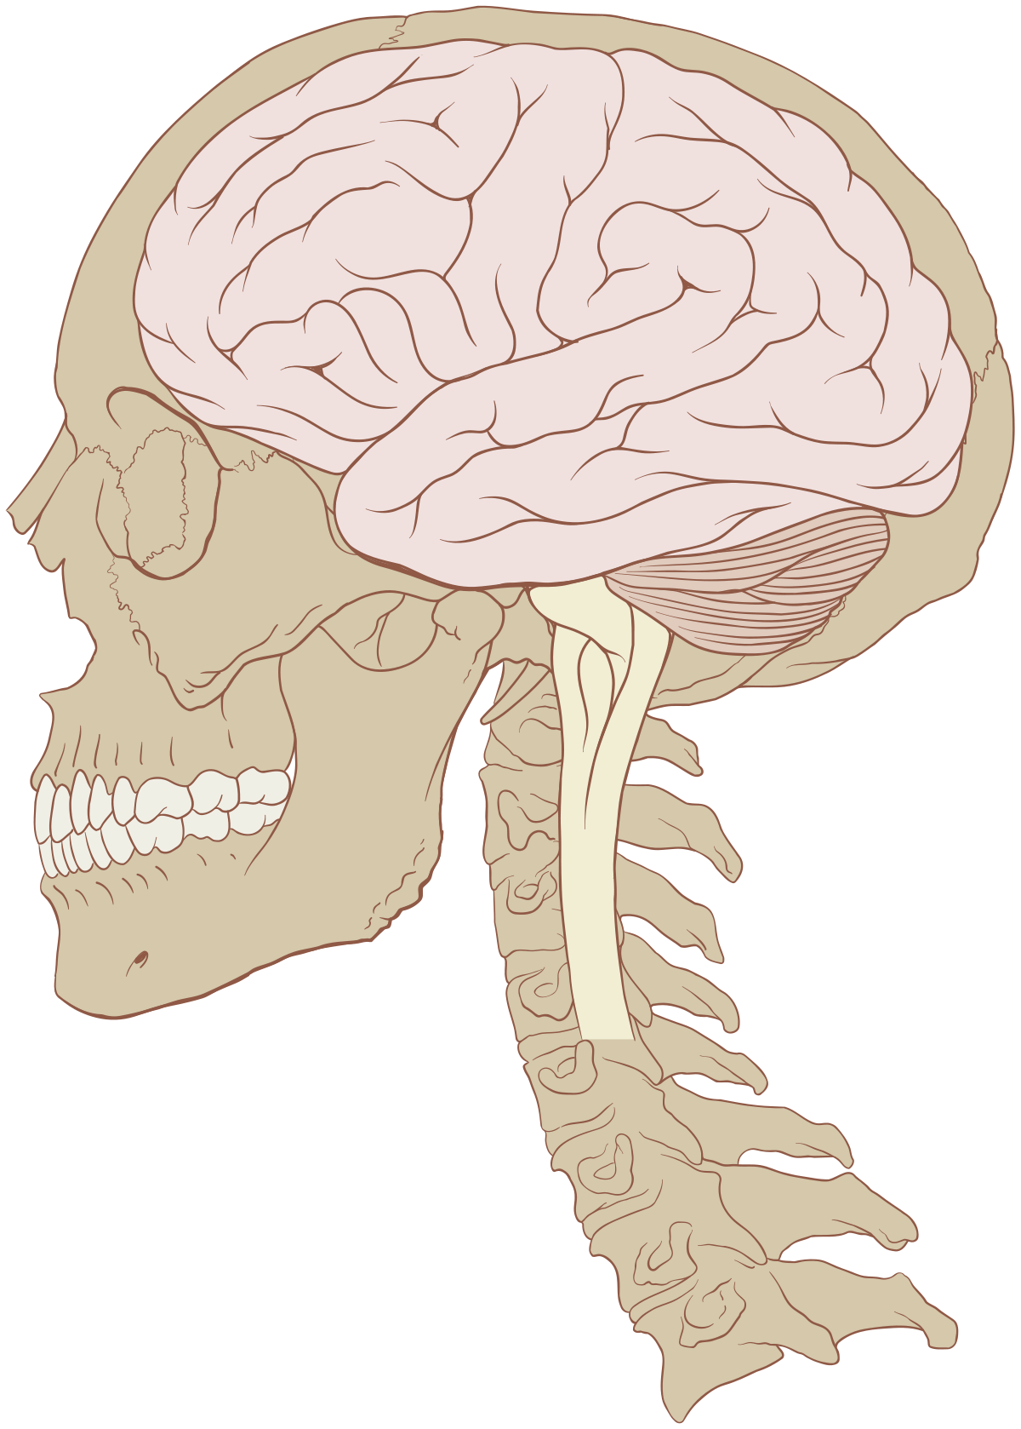

NUS ADC
Send wireless data
Low power
Receive wireless data
Convert and store data in memory
Filter the stored data

Slide 9
Question?

